Slide 1
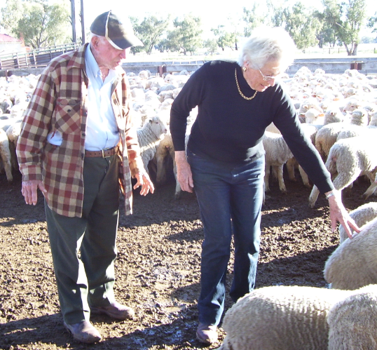
Reablement and Living Well in Long Term Care
Ian Cameron
Professor of Rehabilitation Medicine and Head, John Walsh Centre for Rehabilitation Research, University of Sydney
15th World Congress on Long Term Care in Chinese Communities
“Sustainable and Quality Long Term Care Services”
Hong Kong
29 November 2018

Slide 2
Acknowledgements and Disclosures
No commercial disclosures for this talk
Australian National Health and Medical Research Council support : to Cognitive Decline Partnership Centre and Practitioner Fellowship (Ian Cameron)
Acknowledgements
Professor Susan Kurrle
Hammond Care (Australia)

Slide 3
The Congress and its Theme
The Congress theme:
“Sustainable and Quality Long Term Care Services”
Integrates all aspects of aged care and long term care in Chinese Communities all over the world
Involves practitioners in social policy, academics, researchers, healthcare and long term care service providers
Long Term Care will vary between countries and cultures

Slide 4
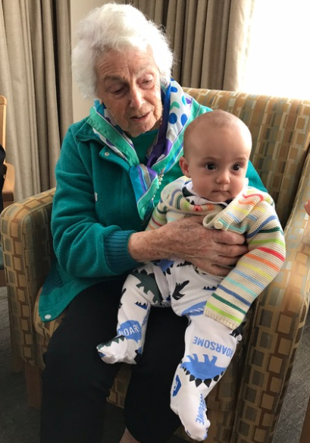
Summary – including case study
Background
Traditional approaches to “living well”
Health related quality of life
Is quality of life in Long Term Care different?
Guidelines / Reablement
Application with Mrs L
Controversies

Slide 5
Long Term Care – what does it mean?
Varies to some extent between countries
With ageing of the world population, substantial expansion of services, in home, community and residential care settings
For this talk it is inclusive of services to assist older people to meet personal care and health needs
National Institute on Ageing (USA) definition:
Long-term care involves a variety of services designed to meet a person's health or personal care needs during a short or long period of time
These services help people live as independently and safely as possible when they can no longer perform everyday activities on their own
Long-term care is provided in different places by different caregivers, depending on a person's needs
www.nia.nih.gov/health/what-long-term-care

Slide 6
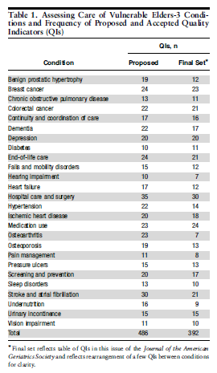
Traditional approaches to “living well”
Managing disease and injury
Health and medical care model
Assessing Care of Vulnerable Elders (ACOVE) indicators
However, the reality for most older people is “multi-morbidity”
Wegner et al, JAGS 55:S247–S252, 2007

Slide 7
What is health? – World Health Organisation Perspective
WHO Health
Health is a state of complete physical, mental and social well-being and not merely the absence of disease or infirmity
WHO Health related quality of life
Quality of Life is an individual's perception of their position in life in the context of the culture and value systems in which they live and in relation to their goals, expectations, standards and concerns.
WHO Other – Functioning
Functioning is an umbrella term for body functions, body structures, activities and participation. It denotes the positive aspects of the interaction between an individual (with a health condition) and that individual’s contextual factors (environmental and personal factors).
www.who.int

Slide 8
Ageing and multimorbidity
Authors’ conclusion: 85 years olds showed good levels both of self rated health and functional ability despite significant levels of disease and impairment
Median disease count
Women 5 (IQR 4 – 6)
Men 4 (IQR 3 – 6)
No-one had zero diseases
Highest prevalence diseases
Hypertension 58%
Osteoarthritis 52%
Collerton et al. BMJ 2009;399:b4904

Slide 9
Quality of life – differences between older and younger people
Differences – control, independence, mobility, mental health
Ratcliffe J et al. Qual Life Res. 2017 Feb;26(2):299-309.

Slide 10
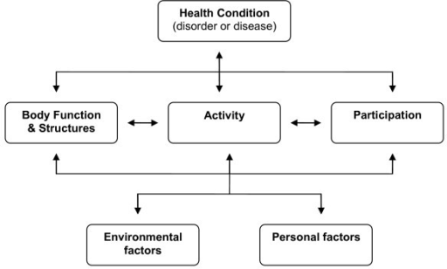
Reablement / Rehabilitation approach with older people
Goals using a WHO
International Classification of Functioning approach
Activity limitations
Participation restrictions
Environmental and personal factors
Body function (and structure) , and health condition
www.who.int

Slide 11
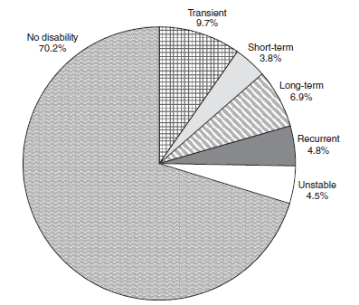
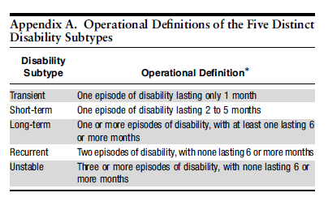
Disability and Rehabilitation at the Population Level
Disability can be temporary in older people
Gill T et al. J Am Geriatr Soc 56:436–443, 2008.

Slide 12
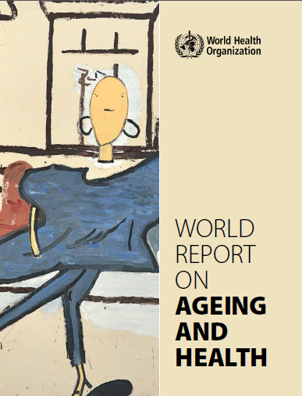
WHO – World Report on Ageing and Health
Supports “ageing in place”
Notes effectiveness of rehabilitation
Supports development of health systems and long term care systems
Suggests optimising trajectories of intrinsic capacity
http://www.who.int/ageing/publications/world-report-2015/en/

Slide 13
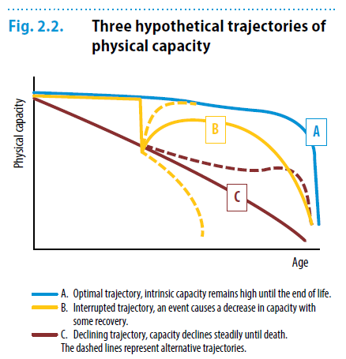
Reablement and Rehabilitation aim to improve physical capacity trajectories
http://www.who.int/ageing/publications/world-report-2015/en/

Slide 14
Mrs L, age 27, 1954
Highly educated
Married
Assisting husband in his work
First child age 2
Predictors of successful ageing
Socioeconomic status
Height
Not smoking
Exercise
Education (in men)
Britton et al. J Am Geriatr Soc. 2008 Jun; 56(6): 1098–1105

Slide 15
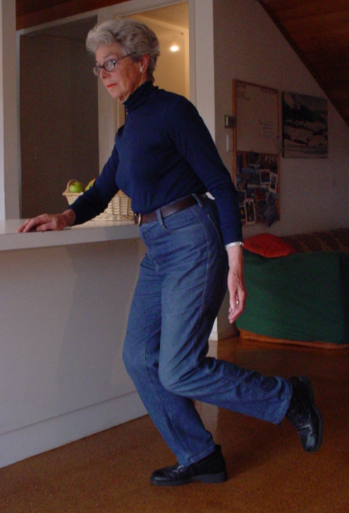
Mrs L , age 80, 2008
Mixed dementia (Alzheimer’s disease and vascular dementia) diagnosed
Health otherwise good with hypertension and osteoarthritis of knees
Supported by husband
Carer strain but attempts to arrange respite care not successful
No other long term care services
Disability related to dementia increasing – some incontinence, husband taking over daily tasks, some agitation

Slide 16
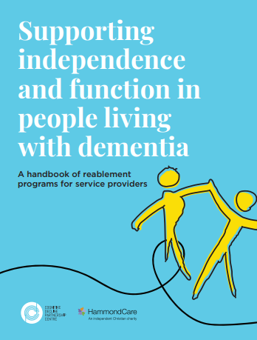
Reablement Approaches in Long Term Care
Processes that aim to assist the person to increase independence in daily life
Applies in long term care to older people with disabilities related to various health condition, particularly dementia and frailty
sydney.edu.au/medicine/cdpc/resources/reablement.php

Slide 17
What is Reablement?
Reablement “involves time-limited interventions that are targeted towards a person's specific goal or desired outcome to adapt to some functional loss or regain confidence and capacity to resume activities” (Australian Department of Health)
Rehabilitation “is a set of interventions designed to optimize functioning and reduce disability in individuals with health conditions in interaction with their environment” (WHO)
Restorative care “aims to reverse and/or slow ‘functional decline’ in older people and improve their wellbeing” (Australian Department of Health)

Slide 18
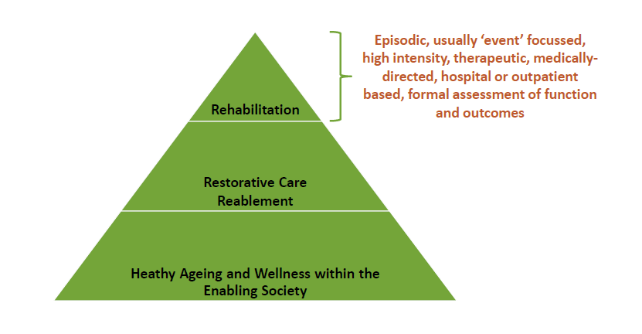
Reablement is one of the rehabilitation species
Slide from Prof Chris Poulos

Slide 19
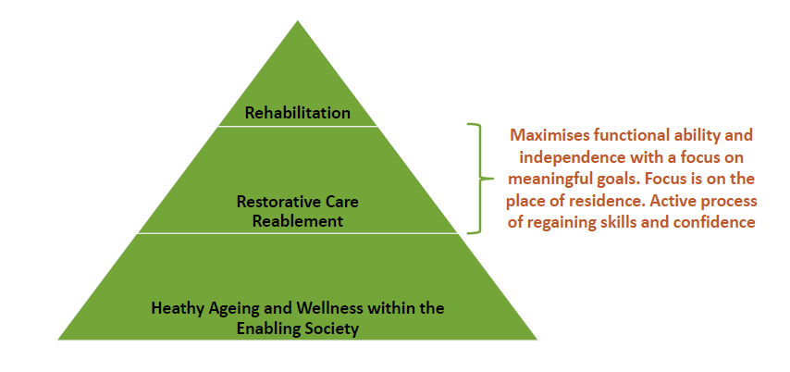
Reablement is one of the rehabilitation species
Slide from Prof Chris Poulos

Slide 20
A Case Study – thinking about reablement – differing issues and settings – Mrs L
Living with dementia or disability at home
Exercise
Location
Supervision
Type
Dose
Intensity
Duration
Progression
http://www.who.int/dietphysicalactivity/factsheet_olderadults/en/

Slide 21
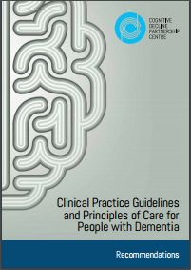
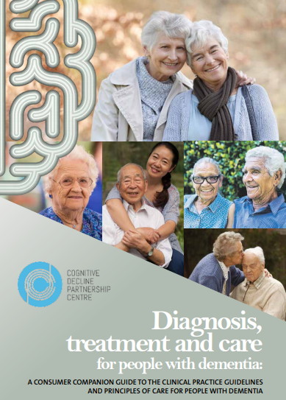
Guidelines can help people live well
Adaptation of United Kingdom Guidelines to Australia
http://sydney.edu.au/medicine/cdpc/resources/dementia-guidelines.php

Slide 22
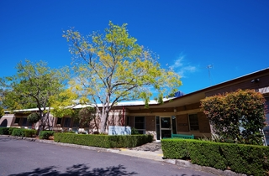
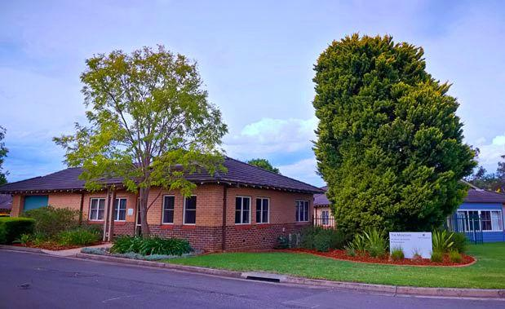
Mrs L, age 88, early 2016
Husband died
Moved to residential long term care
Absconded from non secure unit on a number of occasions
Marked agitation
Staff requested sedation
Transfer to secure (locked exit doors and high fence) request by long term care provider

Slide 23
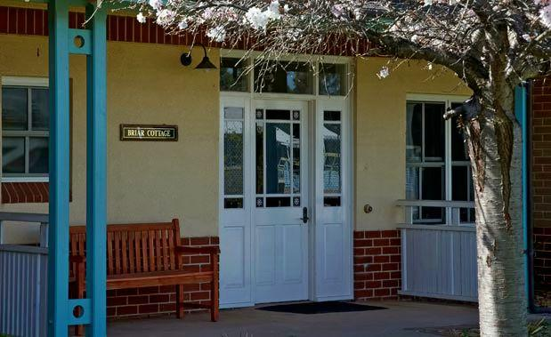
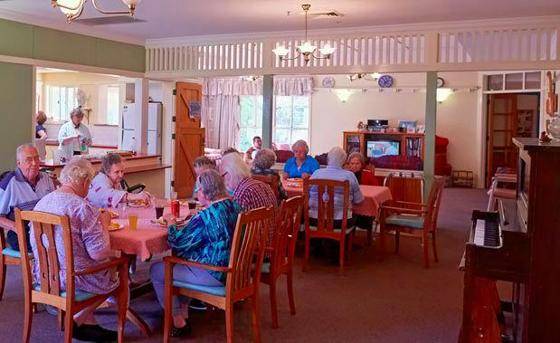
Mrs L, age 88, March 2016
Moved to dementia specific unit with “cottage model of care”
12 residents in house
Residents assist staff to cook all meals in house kitchen
Access to outside from several doors in facility with garden and paths
residents assist with doing own laundry and hang it out
residents “go shopping” in facility supermarket
Regular reassurance from staff, given phone to speak with family
Taken for walks of 2 to 3 kms every day with staff or volunteers
Distracted when became distressed by being taken for a walk, or shopping, or looking at photo albums, or assisting in kitchen with other residents

Slide 24
Clustered domestic residential long term care

Slide 25
Dyer et al (2018) Med J Aust 208 (10): 433-438, doi: 10.5694/mja17.00861

Slide 26
Reablement Approaches in Long Term Care
Supporting everyday activities
through occupational therapy, exercise and a cognitive program
Supporting mobility and physical function
through falls prevention and exercise
Supporting cognition and communication
through a cognitive program, exercise and a communication program
Each approach – sub-classified by setting (home, community, residential care), and some other factors
sydney.edu.au/medicine/cdpc/resources/reablement.php

Slide 27
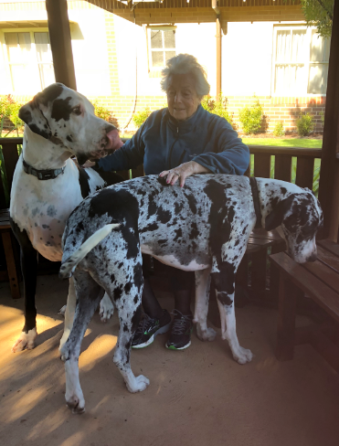
A Case Study – thinking about reablement – differing issues and settings – Mrs L
Living in residential care
Exercise
Supporting everyday activities
Cognitive stimulation
sydney.edu.au/medicine/cdpc/resources/reablement.php

Slide 28
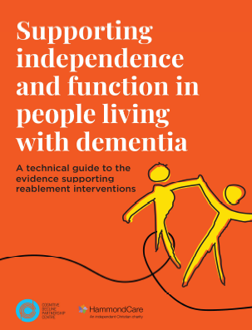
Reablement Approaches - observations
Some evidence stronger than other types eg exercise versus cognitive stimulation
Model plans are directly and readily applicable in the real world
There is a huge gap between knowledge and clinical practice
Much easier to prescribe medication than reablement

Slide 29
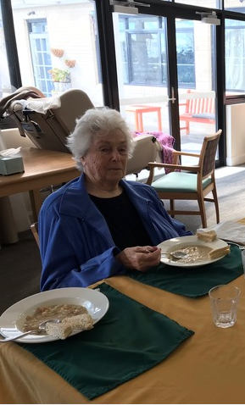
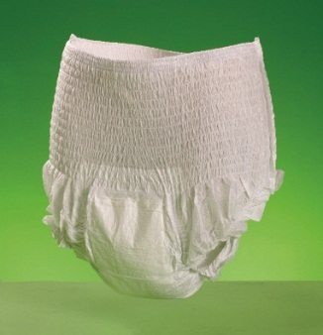
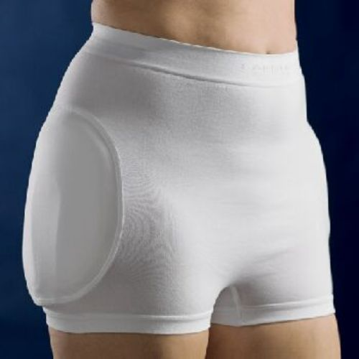
Mrs L, age 88 - 89, 2016 and 2017
Health issues
Urinary incontinence
Severe agitation
Behavioural and psychological problems
Knee pain and difficulty walking
Solutions
Appropriate continence aids
Recognition of urinary tract infection
Medications
Hip protectors
Vitamin D supplement
Continue supporting everyday activities

Slide 30
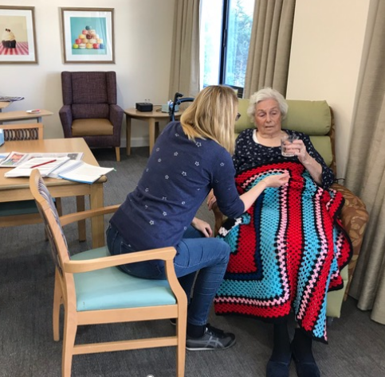
Mrs L, age 89, April 2018
Problem
Developed eating dyspraxia and became unable to use a knife and fork
Weight loss
Solution:
Careful hand feeding
Nutritional supplements (high protein) commenced twice daily between meals
Puree food
http://sydney.edu.au/medicine/cdpc/resources/dementia-guidelines.php

Slide 31
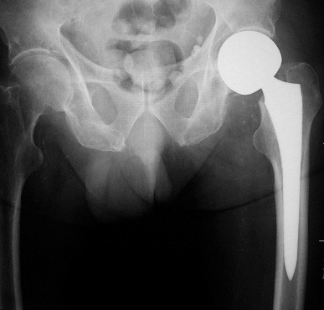
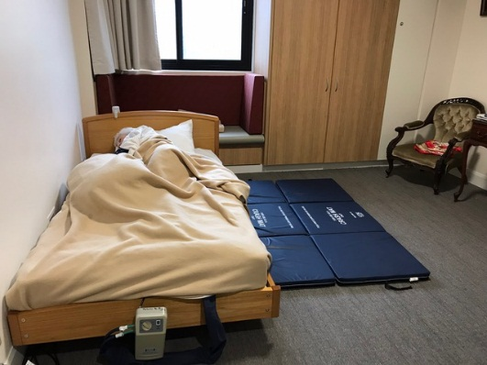
Mrs L, age 90, September 2018
Problem:
Fell when going to bed, not wearing hip protectors, sustained subcapital fracture of left femur
Solution:
L hip hemiarthroplasty with good position
Post operative delirium, mainly hypo-alert, also gait dyspraxia resulting in difficulty with mobilizing
Returned to facility, very reluctant to mobilise
Staff using standing lifter to mobilise
Supplied with low bed, pressure mattress, and crash mats
2nd daily physiotherapy to attempt mobilisation
Re fracture prevention

Slide 32
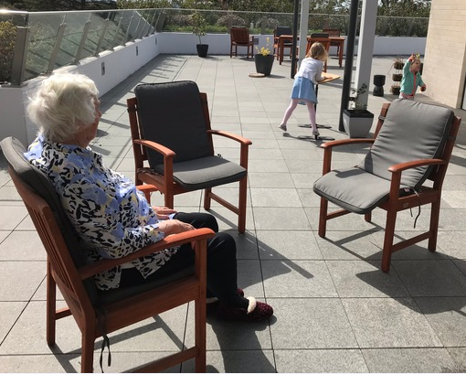
Mrs L, age 90, November 2018
Problem:
Limited mobility
Solution:
Walking with family
Reducing medications

Slide 33
Controversies
Other controversies
Regulation / safety
Consumer directed care
Supported decision making
End of life issues
Training
Funding
www.theguardian.com/australia-news/2018/sep/16/morrison-to-announce-royal-commission-into-aged-care-after-string-of-scandals

Slide 34
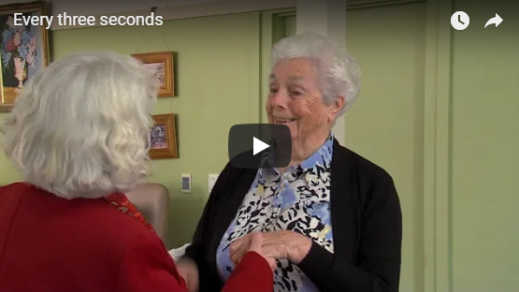
Conclusion
Living well in Long Term Care means different things at different times, and in different places
Aim for “ageing in place”
Aim for home or a home like environment
Have a reablement approach
sydney.edu.au/medicine/cdpc/

Slide 35
Further details:
Ian Cameron
ian.cameron@sydney.edu.au

